Slide 1
Running Experiments Using
jsPsych and MySQL
Ruth Shaffer
Memory & Cognition Lab Meeting
30 May 2017

Slide 2
Outline
Links & starting tips
Set up a local web development environment
Get going with jsPsych basics
Set up MySQL database and table
Hook jsPsych up with MySQL database & table
Understand MySQL table and data insertions
Use developer tools
Get your data into your MySQL table
Miscellaneous tips
MTurk basics

Slide 3
Outline
Links & starting tips
Set up a local web development environment
Get going with jsPsych basics
Set up MySQL database and table
Hook jsPsych up with MySQL database & table
Understand MySQL table and data insertions
Use developer tools
Get your data into your MySQL table
Miscellaneous tips
MTurk basics

Slide 4


Links and Tips
RECOMMENDED
LINKS
MAMP 3.5.2 https://www.mamp.info/en/downloads/older-versions/
Current jsPsych https://github.com/jodeleeuw/jsPsych/releases
jsPsych tutorial 1 http://docs.jspsych.org/tutorials/hello-world/
jsPsych tutorial 2 http://docs.jspsych.org/tutorials/rt-task/
Web path to manual experiment http://localhost/jspsych_manual/experiment2.html
jsPsych data storage http://docs.jspsych.org/features/data/
MTurk https://www.mturk.com/mturk/welcome
MTurk individual subject https://requester.mturk.com/workers/<WORKER_ID>

Slide 5
Links and Tips
CODE SNIPPETS
1
/Applications/MAMP/Library/bin/mysqladmin -u root -p password
2
CREATE TABLE `manual_table2` (
`rt` int(11) NOT NULL,
`key_press` smallint(11) NOT NULL,
`trial_type` varchar(200) NOT NULL,
`trial_index` smallint(6) NOT NULL,
`time_elapsed` int(11) NOT NULL,
`internal_node_id` varchar(300) NOT NULL,
`subject` int(11) NOT NULL,
`conditions` varchar(200) NOT NULL,
`stimulus` varchar(200) DEFAULT NULL,
`response` varchar(100) DEFAULT NULL,
`correct` varchar(100) DEFAULT NULL
) ENGINE=InnoDB DEFAULT CHARSET=utf8
3
SHOW CREATE TABLE manual_table2;

Slide 6
Outline
Links & starting tips
Set up a local web development environment
Get going with jsPsych basics
Set up MySQL database and table
Hook jsPsych up with MySQL database & table
Understand MySQL table and data insertions
Use developer tools
Get your data into your MySQL table
Miscellaneous tips
MTurk basics

Slide 7
Set up local web development environment
MAMP: MacOS, Apache, MySQL, PHP/Python/Perl
- Apache: server
- MySQL: database management
- PHP: language we will use to interface with MySQL
Or can set it all up manually
- PowerPoint vs. manual

Slide 8
Set up local web development environment
Necessary for local development and testing of your experiment
Final testing on Giraffe, but initial development and testing should not be public or on the testing server

Slide 9
Set up local web development environment
MAMP version 3.5.2
- not most recent
- how it works with jsPsych code for MySQL storage
- (we want earlier PHP version)
Download MAMP (not MAMP PRO) for Mac
- see MAMP download link
Launch installer

Slide 10
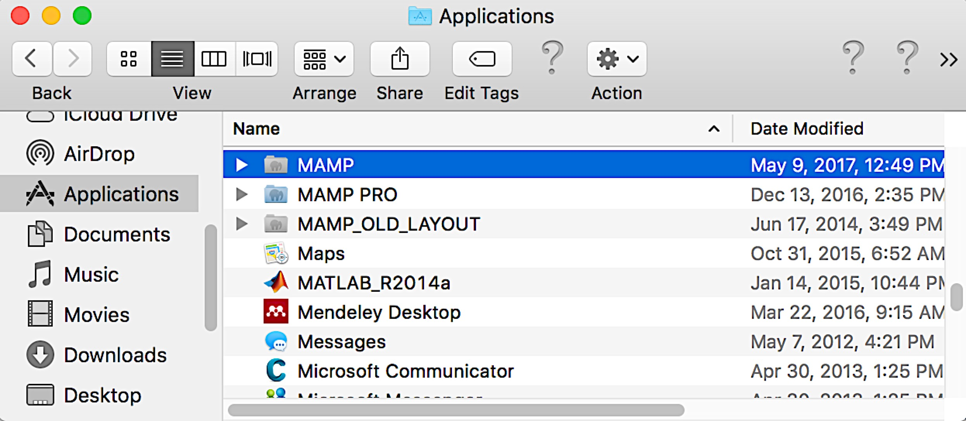
Set up local web development environment
✔
✗

Slide 11
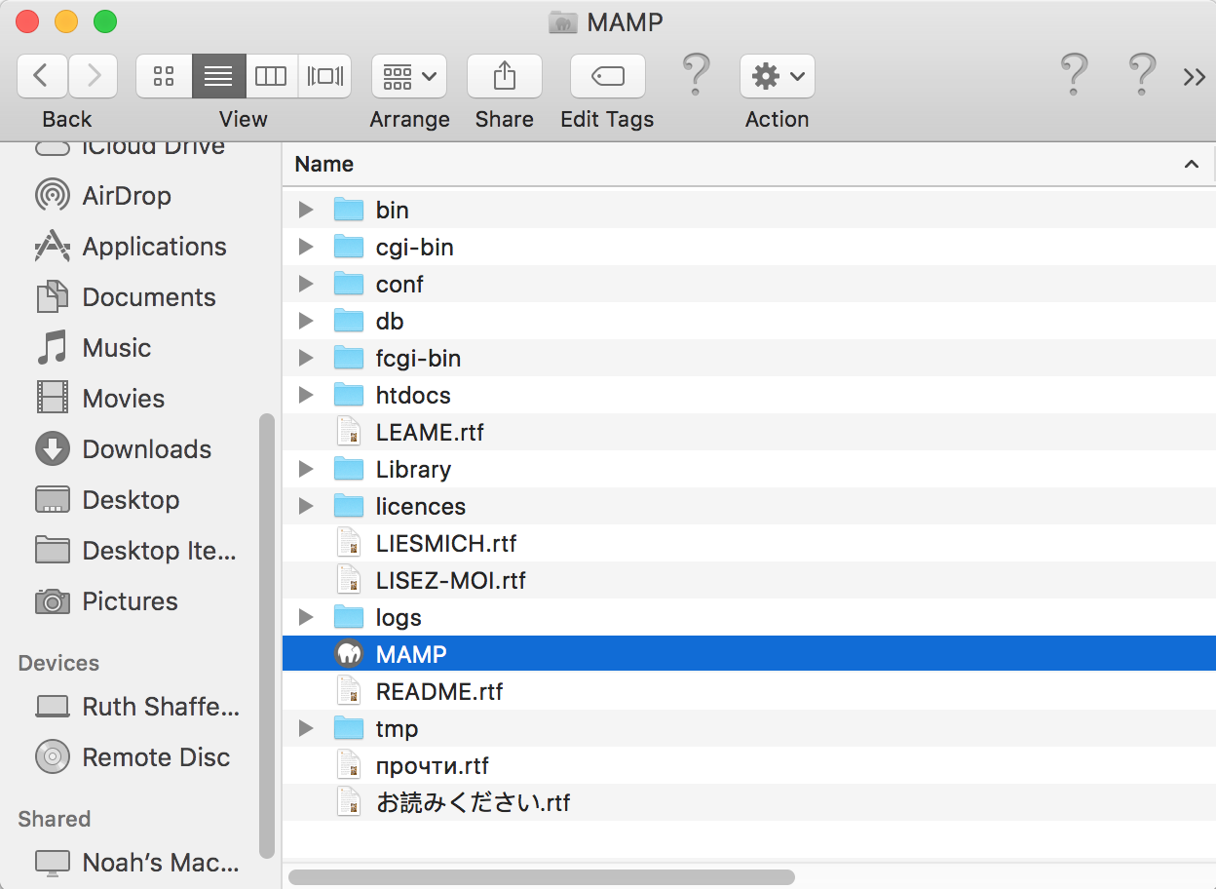
Set up local web development environment
In a popup, you may have to select Launch MAMP (not launch MAMP PRO)

Slide 12
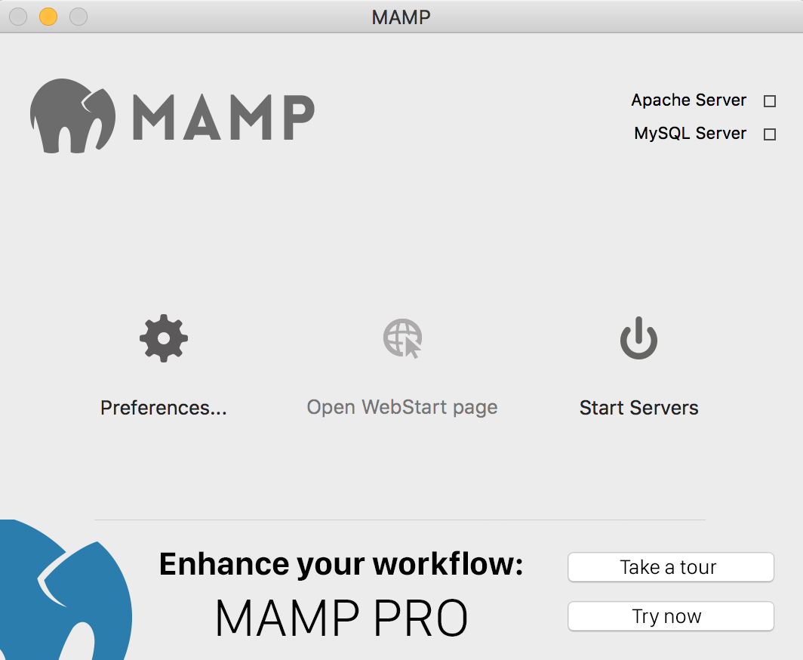
Set up local web development environment

Slide 13
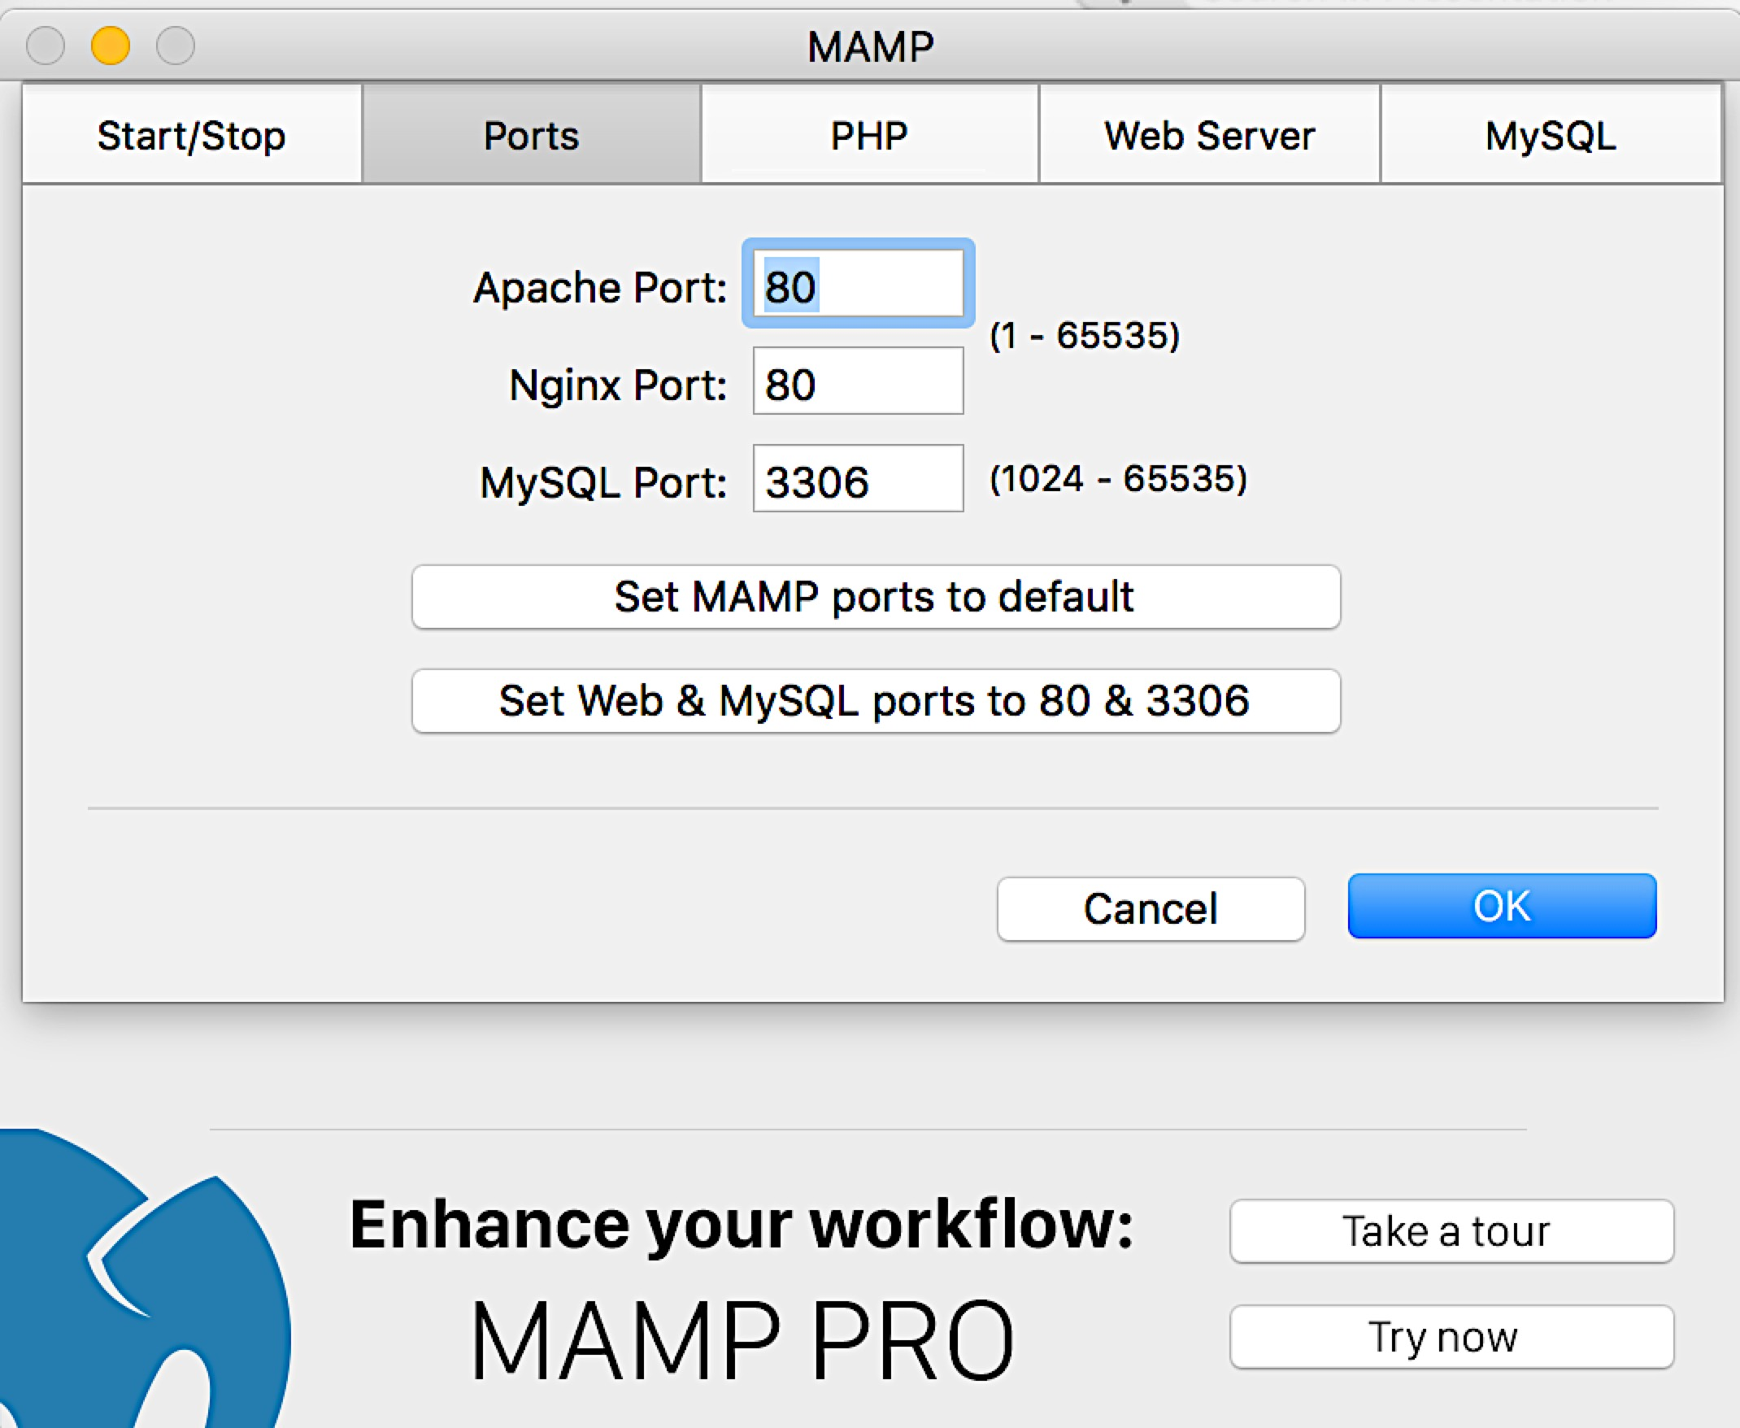
Set up local web development environment

Slide 14
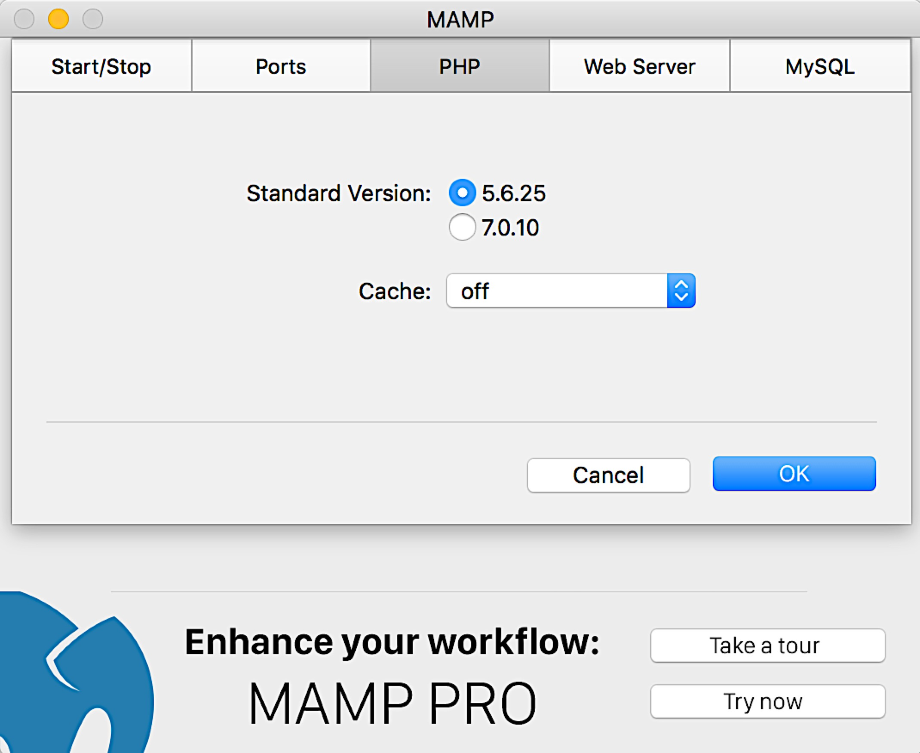
Set up local web development environment
Or 5.X.X
(just not 7)
Then hit OK

Slide 15
Set up local web development environment
From now on can start with this step

Slide 16
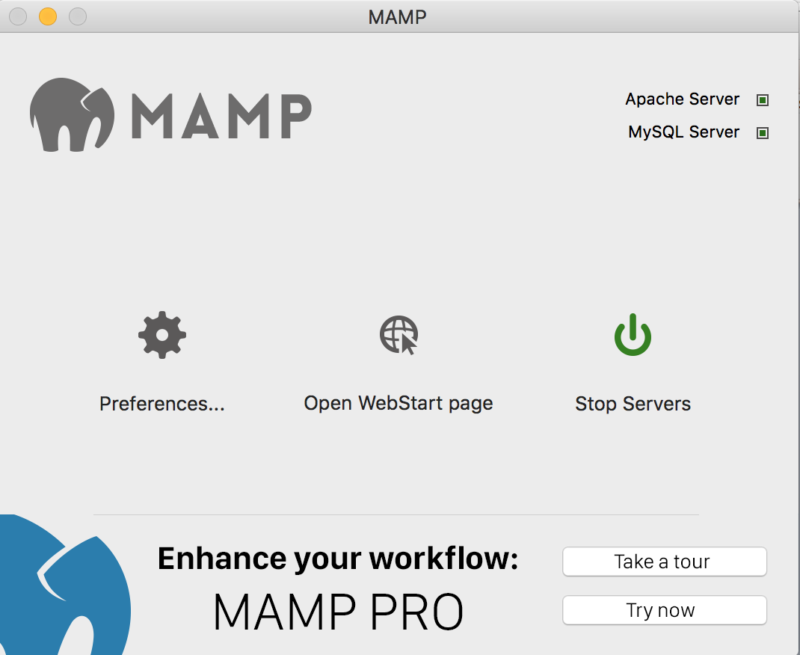
Set up local web development environment

Slide 17
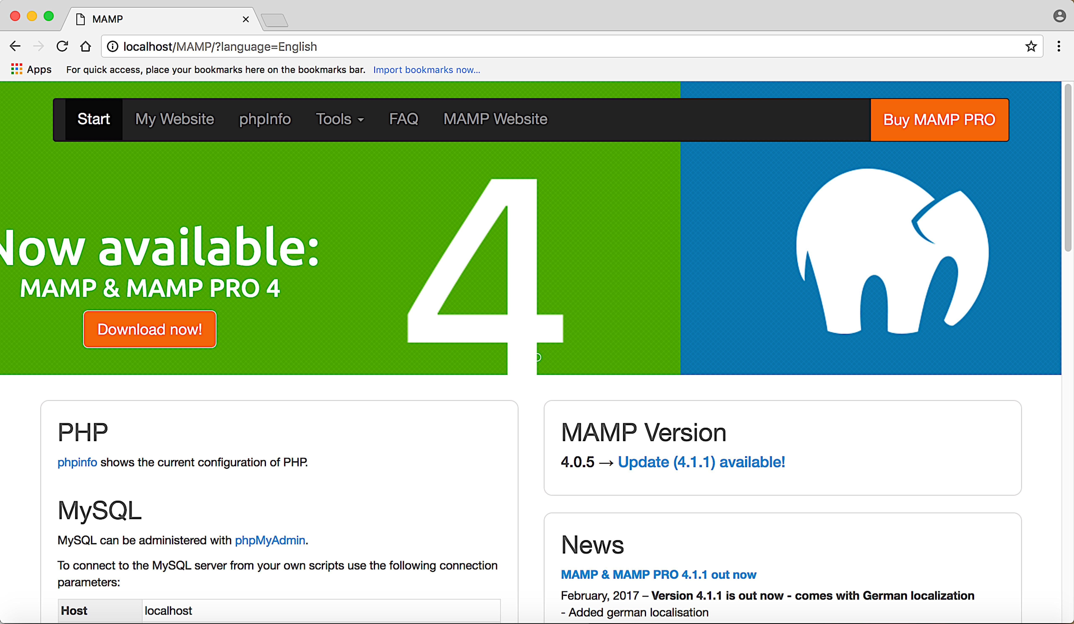
Set up local web development environment

Slide 18
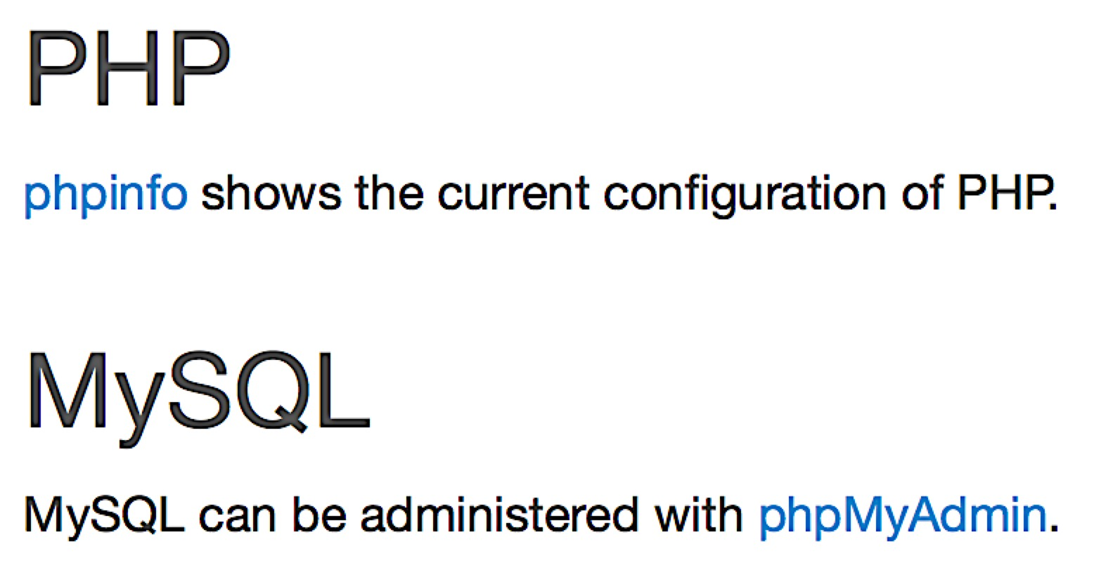
Set up local web development environment
Helpful configuration summary
Links to GUI to deal with MySQL database and tables.
Click to make sure phpMyAdmin is working

Slide 19
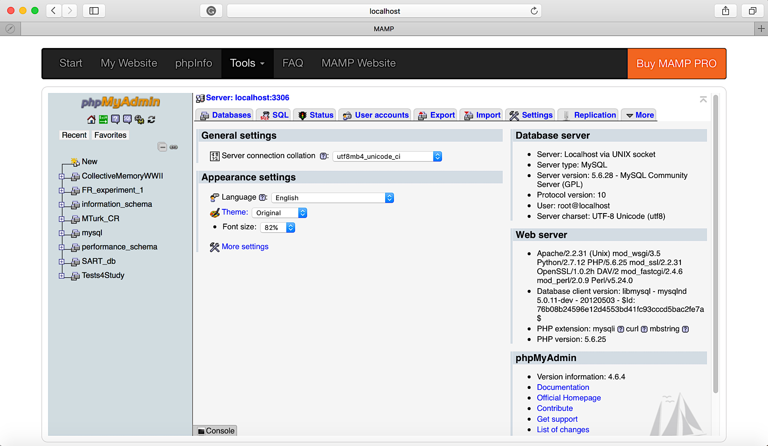
Set up local web development environment
Switch to Chrome if not working properly. Once you see it’s working, you can close out.

Slide 20
Set up local web development environment
Current username/password for phpMyAdmin account:
- root/root
Let’s change that to:
- root/<passwordOfYourChoosing>

Slide 21
Set up local web development environment

Slide 22
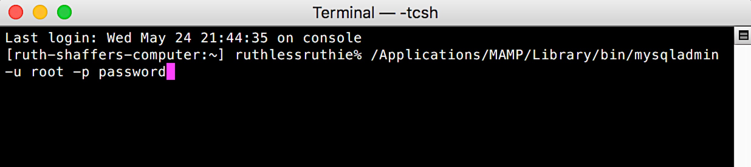
Set up local web development environment
For copying: /Applications/MAMP/Library/bin/mysqladmin -u root -p password
When prompted for each:
Enter current password (root)
New password (you’ll need this again soon)
And again new password to verify

Slide 23
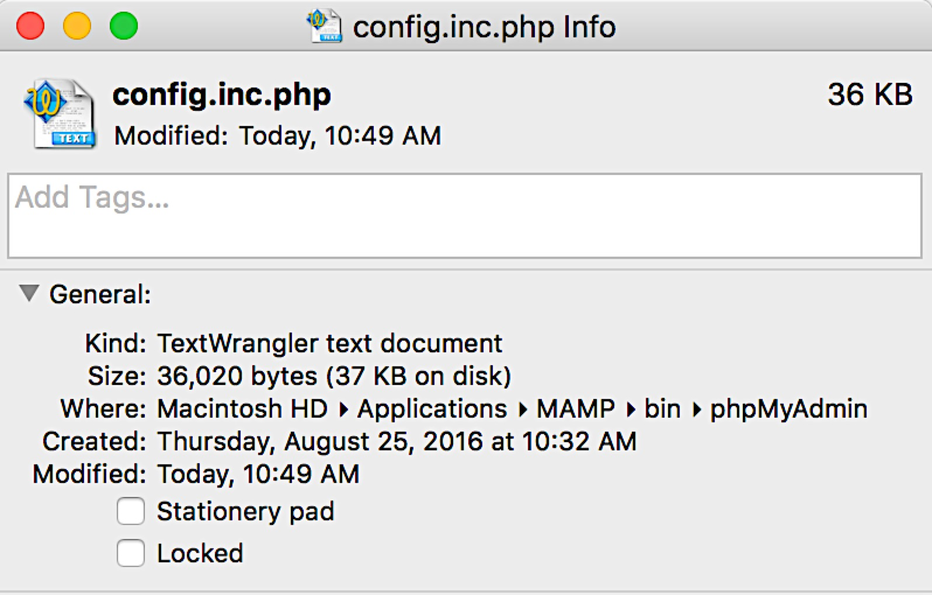
Set up local web development environment

Slide 24
Set up local web development environment
Search “root” and this will come up
Replace password root with <passwordOfYourChoosing>

Slide 25
Set up local web development environment
To verify that this is all working, as before:
1. Start MAMP server (or Stop and Start it)
2. Open WebStart Page
3. Select phpMyAdmin link and make sure it opens (no permission issues)

Slide 26
Outline
Links & starting tips
Set up a local web development environment
Get going with jsPsych basics
Set up MySQL database and table
Hook jsPsych up with MySQL database & table
Understand MySQL table and data insertions
Use developer tools
Get your data into your MySQL table
Miscellaneous tips
MTurk basics

Slide 27
Get going with jsPsych basics
jsPsych provides great documentation
- 2 great tutorials
- tons of helpful explanations of plugins / examples
For today, we’ll just set up and quickly walk through their tutorial code
- see jsPsych Tutorial 1 link

Slide 28
Get going with jsPsych basics
Per jsPsych’s Tutorial 1 (Hello World Tutorial)
Download jsPsych library via link they provide in Step 1
- or see jsPsych download link
Unzip the folder
- brief walk-through of contents
Step 2 says to make a folder for the jsPsych library on your computer
- We will use MAMP’s htdocs (serving) folder

Slide 29
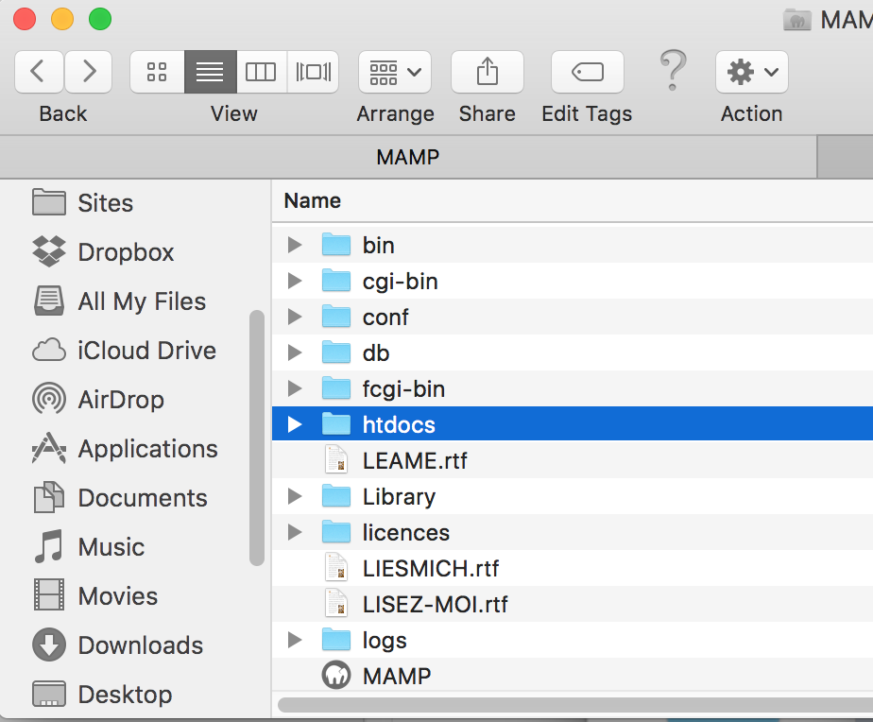
Get going with jsPsych basics
So create a folder called “jspsych_manual” in the htdocs folder
Then, place the jspsych library within the “jspsych_manual” folder

Slide 30
Get going with jsPsych basics
For time purposes, we’ll skip the rest of Tutorial 1 and go to the end of Tutorial 2:
- see jsPsych Tutorial 2 link
experiment2.html in manual folder
It’s a copy of the code at the bottom of the tutorial page under “The final code”
Save file in the same level as the jsPsych library
Path: /Applications/MAMP/htdocs/jspsych_manual/experiment2.html

Slide 31
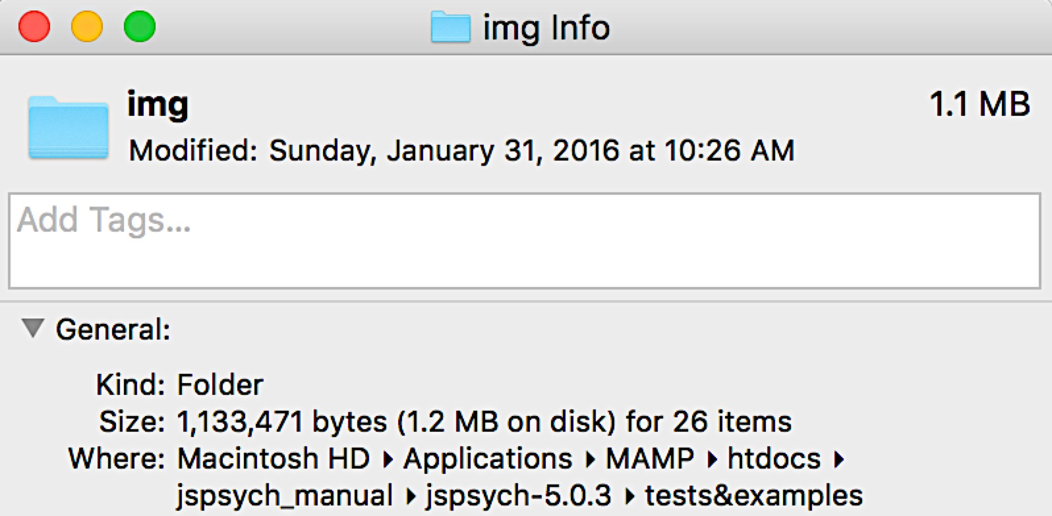
Get going with jsPsych basics
Brief walk through of code…
Changes to make:
1. src paths to correct jsPsych folder
2.
3. copy ‘img’ folder to same level as experiment2.html

Slide 32
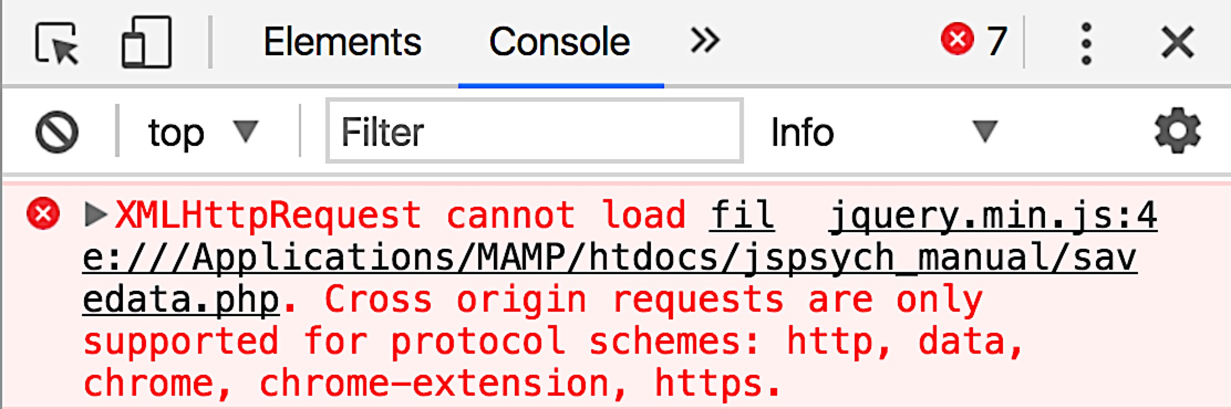
Get going with jsPsych basics
To run the experiment, do not click html file in folder.
Appears to work, but when it comes time to store outputs:
The path is incorrect and will look like this:
file:///Applications/MAMP/htdocs/jspsych_manual/experiment2.html

Slide 33
Get going with jsPsych basics
Instead, in Chrome, go to:
http://localhost/jspsych_manual/experiment2.html
or localhost:8888/jspsych_manual/etc...
whatever appears as the pre- “MAMP” portion of the web address when you click the MAMP Open WebStart page button
Run through the code until the end
Notice final data structure output
See next slide

Slide 34
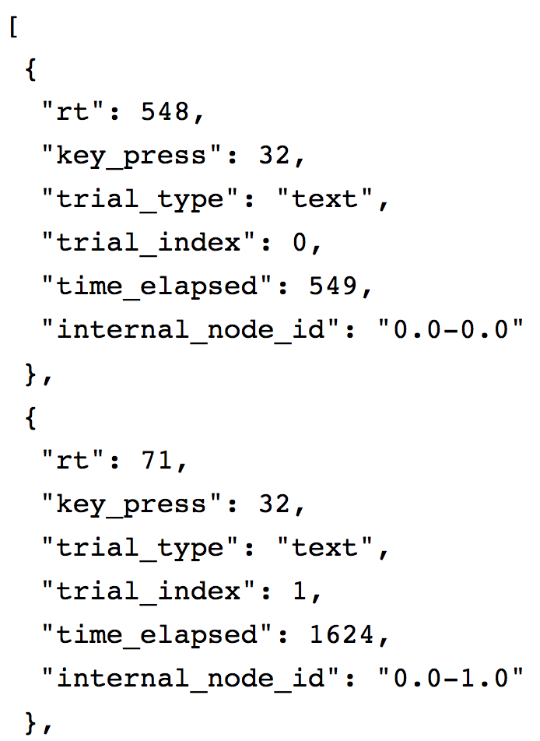
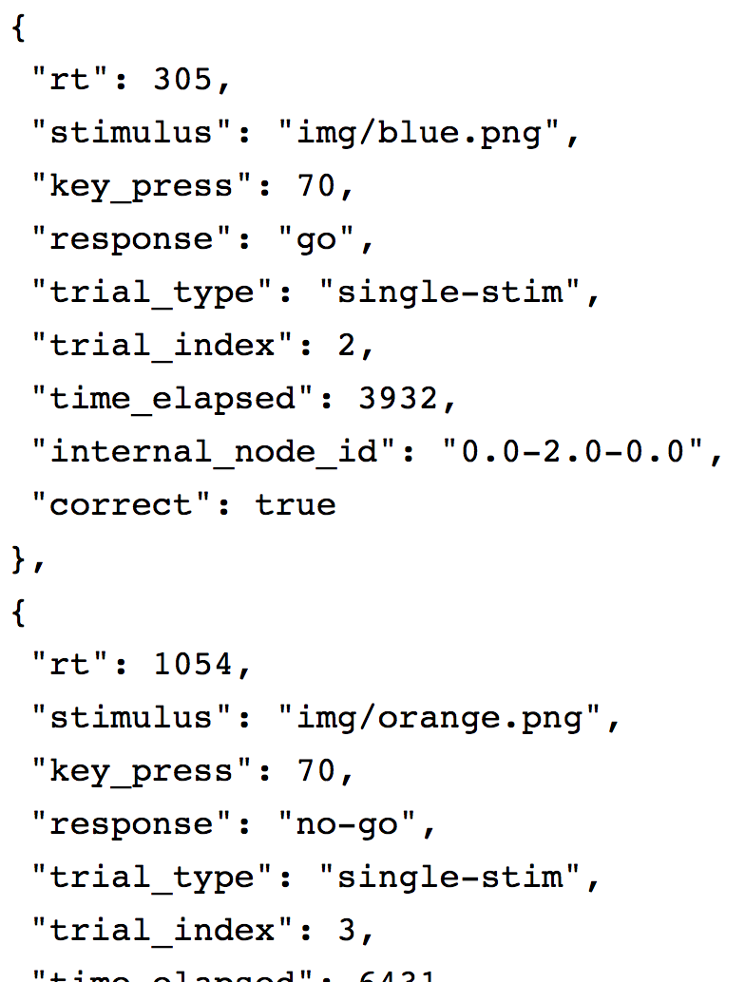
Get going with jsPsych basics
Each is a trial, and we want to store these in a way we can access later.

Slide 35
Get going with jsPsych basics
To store these trial outputs:
- see jsPsych data storage link
experiment2_withExtraData.html in manual folder
- experiment2.html +
changed src to correct jsPsych +
change repeat from 10 → 2 +
copy of the code in jsPsych’s “Adding data to all trials” +
- place file in the directory with your experiment2.html file
Run your this file to see that it worked
- should see added data in output at the end

Slide 36
Get going with jsPsych basics
For the section: “Adding data to a particular trial or set of trials”
- Notice that the code already does this in the test_stimuli variable
- It defines “response” as either “go” or “no-go”
We can skip “Storing data permanently as a file”
But before completing “Storing data permanently in a MySQL database” we need to set up a database on our end

Slide 37
Outline
Links & starting tips
Set up a local web development environment
Get going with jsPsych basics
Set up MySQL database and table
Hook jsPsych up with MySQL database & table
Understand MySQL table and data insertions
Use developer tools
Get your data into your MySQL table
Miscellaneous tips
MTurk basics

Slide 38
Set up MySQL database and tables

Slide 39
Set up MySQL database and tables

Slide 40
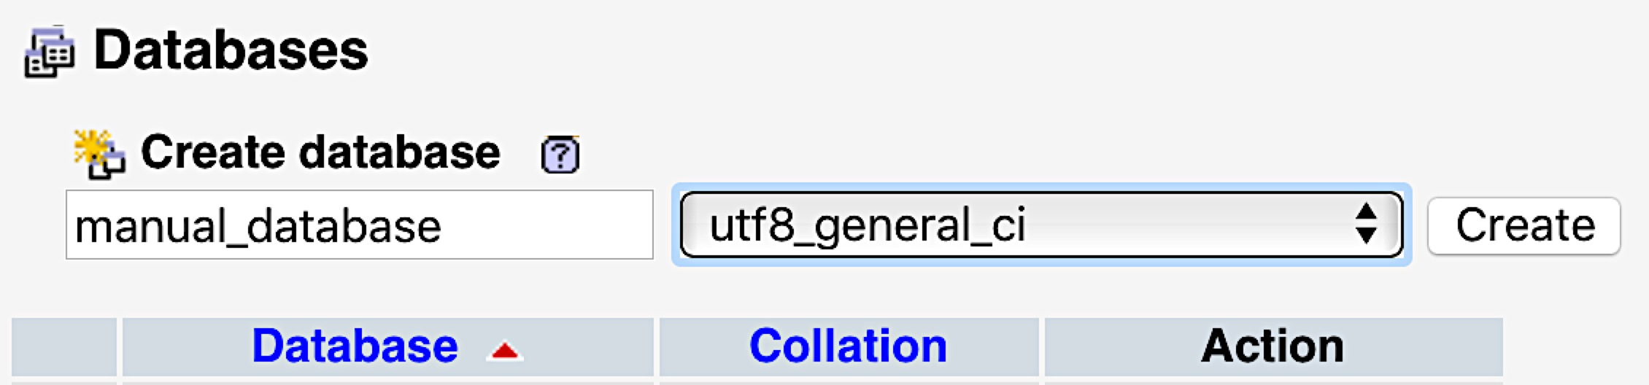
Set up MySQL database and tables
1
2
3

Slide 41
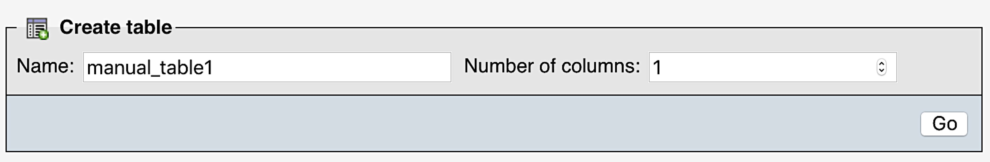
Set up MySQL database and tables
1
2
3

Slide 42
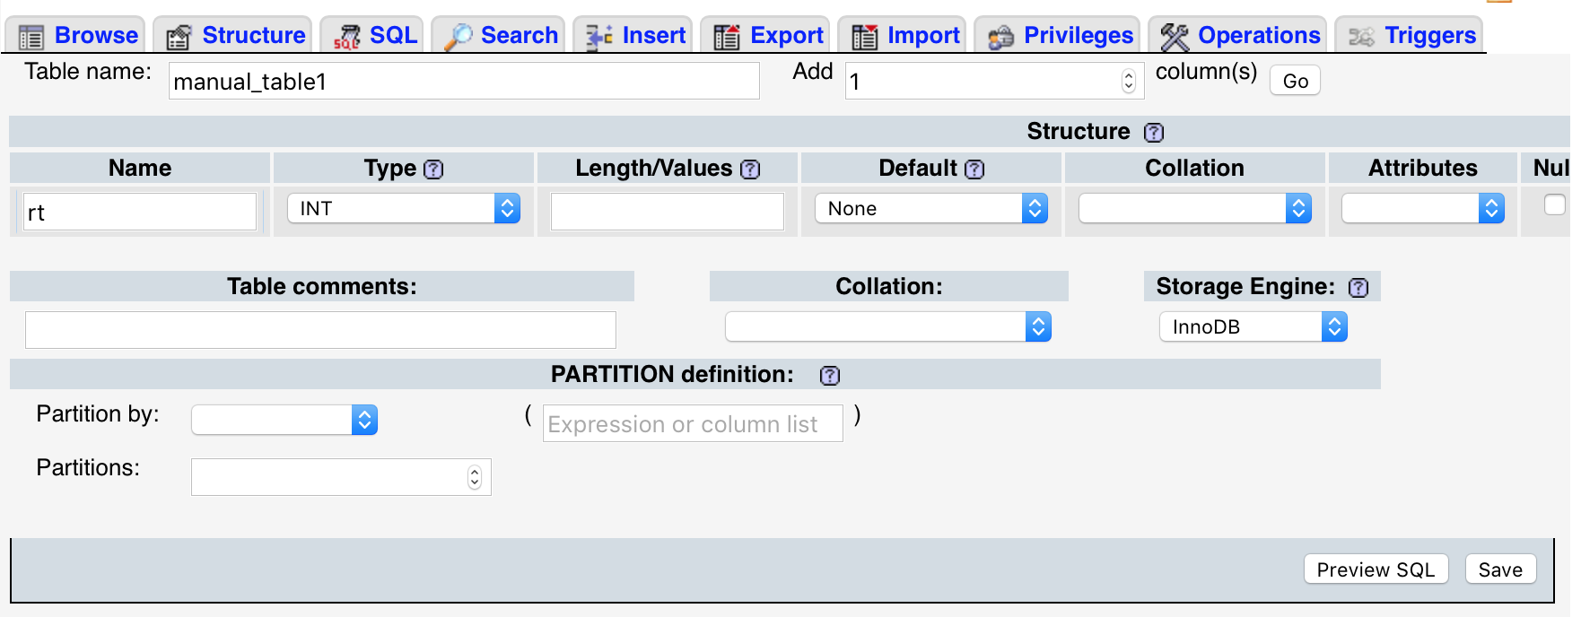
Set up MySQL database and tables
Specify information for the column to hold:
1
2
For now, all else can be left as is
Notes:
More on this later…

Slide 43
Set up MySQL database and tables
So now we have a database and a table with a single column in it

Slide 44
Outline
Links & starting tips
Set up a local web development environment
Get going with jsPsych basics
Set up MySQL database and table
Hook jsPsych up with MySQL database & table
Understand MySQL table and data insertions
Use developer tools
Get your data into your MySQL table
Miscellaneous tips
MTurk basics

Slide 45
Hook jsPsych up with MySQL database & table
Back to jsPsych’s data storage page:
- see jsPsych data storage link
- in jsPsych link see “Storing data permanently in a MySQL database”
jsPsych provides code for 2 files necessary to connect to MySQL, I’ve sent them in the folder
- savedata.php
- database_connect.php

Slide 46
Hook jsPsych up with MySQL database & table
Place these in the experiment folder (same level as experiment2.html)
- will need these 2 files to be accessible to any experiment
- can always link to the same 2 files, or simply place copies of these in any experiment folder you make (this is what I do because I use separate folders for every experiment)

Slide 47
Hook jsPsych up with MySQL database & table
As instructed by jsPsych
See database_connect.php and change:
- username → root
- password → passwordOfYourChoosing
- database name → manual_database

Slide 48
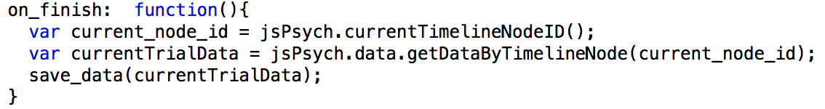
Hook jsPsych up with MySQL database & table
experiment2_withDataStorageEveryTrial.html in manual folder
= experiment2.html +
changed src to correct jsPsych +
change repeat from 10 → 2 +
copy of the code in jsPsych’s “Adding data to all trials” +
jsPsych function to save data in manual_table1 +
commented out opt_data: {key: value} and preceding comma +
commented out final jsPsych.data.displayData() +
code to call save_data function at the end of each trial:
Place in the directory with your experiment2.html file

Slide 49
Hook jsPsych up with MySQL database & table
The save data function calls the savedata.php file, which uses database info from the database_connect.php file
However, it needs to know what table within the database to deal with, so as instructed in the jsPsych function, change the table to reference your table:

Slide 50
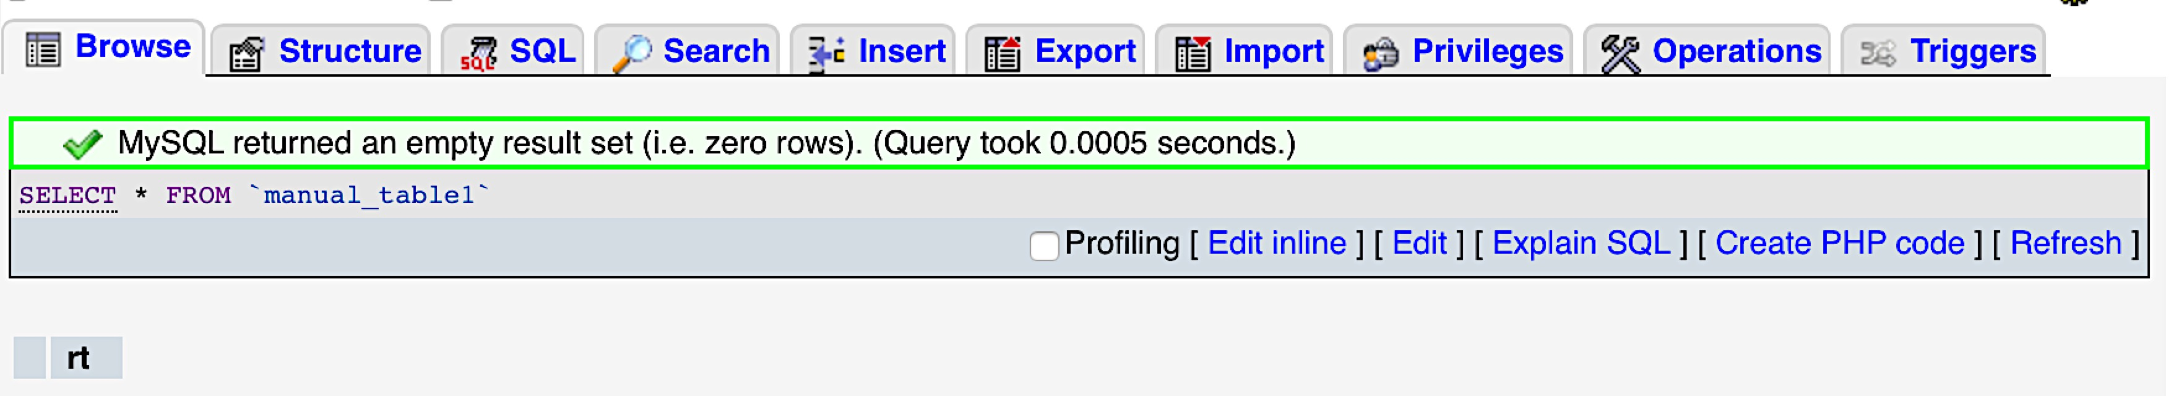
Hook jsPsych up with MySQL database & table
Next, rerun your code.
It should work fine, but if you check your MySQL table it will be empty (no data logged) ☹

Slide 51
Hook jsPsych up with MySQL database & table
At this point, it is necessary to understand the MySQL table structure and how objects (each a trial of your experiment) are inserted into tables.
I made a few schematics on the following 4 slides that I hope will be clarifying.

Slide 52
Outline
Links & starting tips
Set up a local web development environment
Get going with jsPsych basics
Set up MySQL database and table
Hook jsPsych up with MySQL database & table
Understand MySQL table and data insertions
Use developer tools
Get your data into your MySQL table
Miscellaneous tips
MTurk basics

Slide 53
Understand MySQL table and data insertions

Slide 54
Understand MySQL table and data insertions

Slide 55
Understand MySQL table and data insertions

Slide 56
Understand MySQL table and data insertions

Slide 57
Understand MySQL table and data insertions
Hopefully now it’s clear why your MySQL table is completely empty when you click the “Browse” button to see your data.
None of the objects (trials) submitted exactly matched your table specifications

Slide 58
Understand MySQL table and data insertions
But how can you keep track of exactly what data is being sent after each trial, in order to create an appropriate table?

Slide 59
Outline
Links & starting tips
Set up a local web development environment
Get going with jsPsych basics
Set up MySQL database and table
Hook jsPsych up with MySQL database & table
Understand MySQL table and data insertions
Use developer tools
Get your data into your MySQL table
Miscellaneous tips
MTurk basics

Slide 60
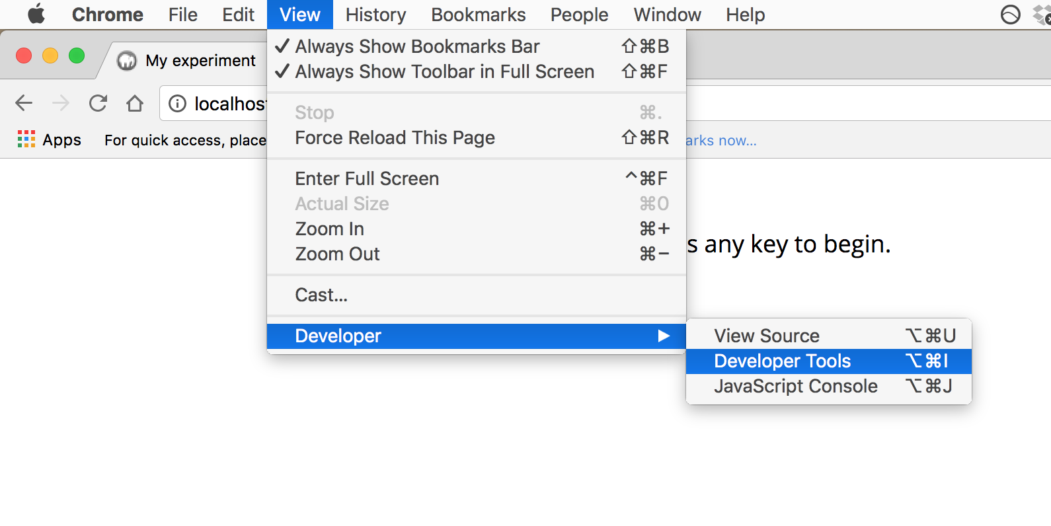
Use developer tools
Open the experiment2_withDataStorageEveryTrial.html file in Chrome, and then…

Slide 61
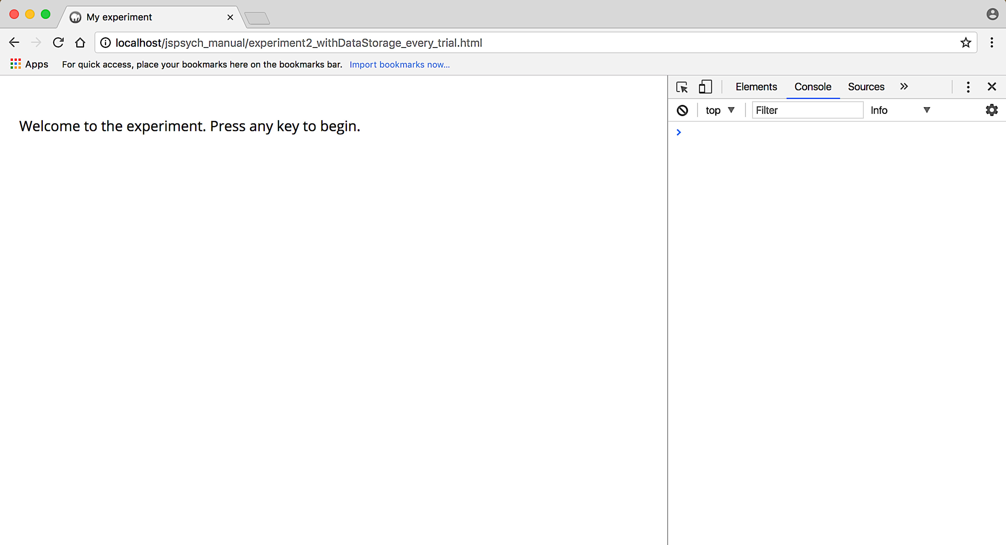
Use developer tools

Slide 62
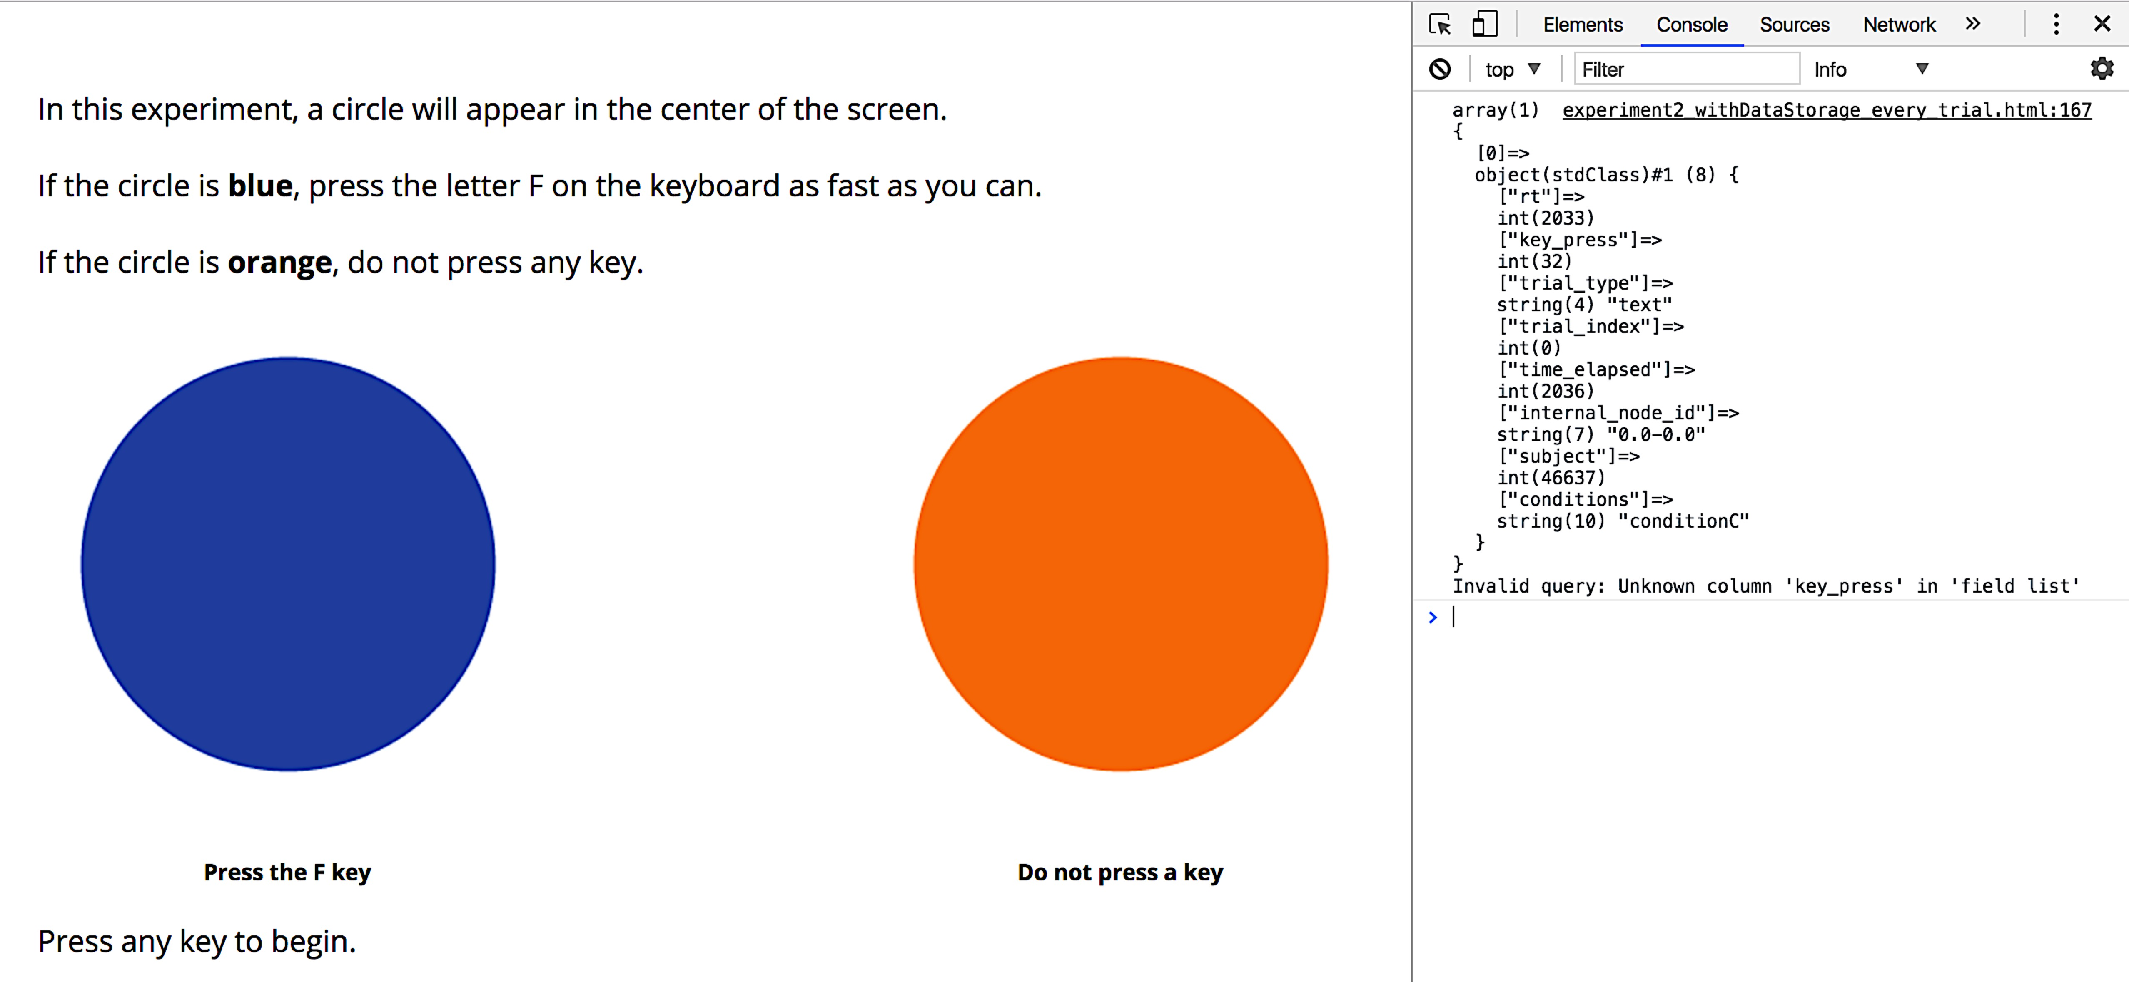
Use developer tools
If you then press a key to begin, you should see this:
This text corresponds to the attempt to insert data into your MySQL table

Slide 63
Use developer tools
If you then press a key to begin, you should see this:
Trial data sent
The first issue with data insertion to table

Slide 64
Use developer tools
If you run through the experiment, you can see each trial data output, as well as its insertion status
Then you know exactly what your table will need, including:
The name of each key
The type of data it holds
Whether or not it will always be sent with the rest of the trial data

Slide 65
Use developer tools
If you run through the experiment, you can see each trial data output, as well as its insertion status
Then you know exactly what your table will need, including:
The name of each key
The type of data it holds
Whether or not it will always be sent with the rest of the trial data
This info lets you create a table to accept / store your data

Slide 66
Outline
Links & starting tips
Set up a local web development environment
Get going with jsPsych basics
Set up MySQL database and table
Hook jsPsych up with MySQL database & table
Understand MySQL table and data insertions
Use developer tools
Get your data into your MySQL table
Miscellaneous tips
MTurk basics

Slide 67
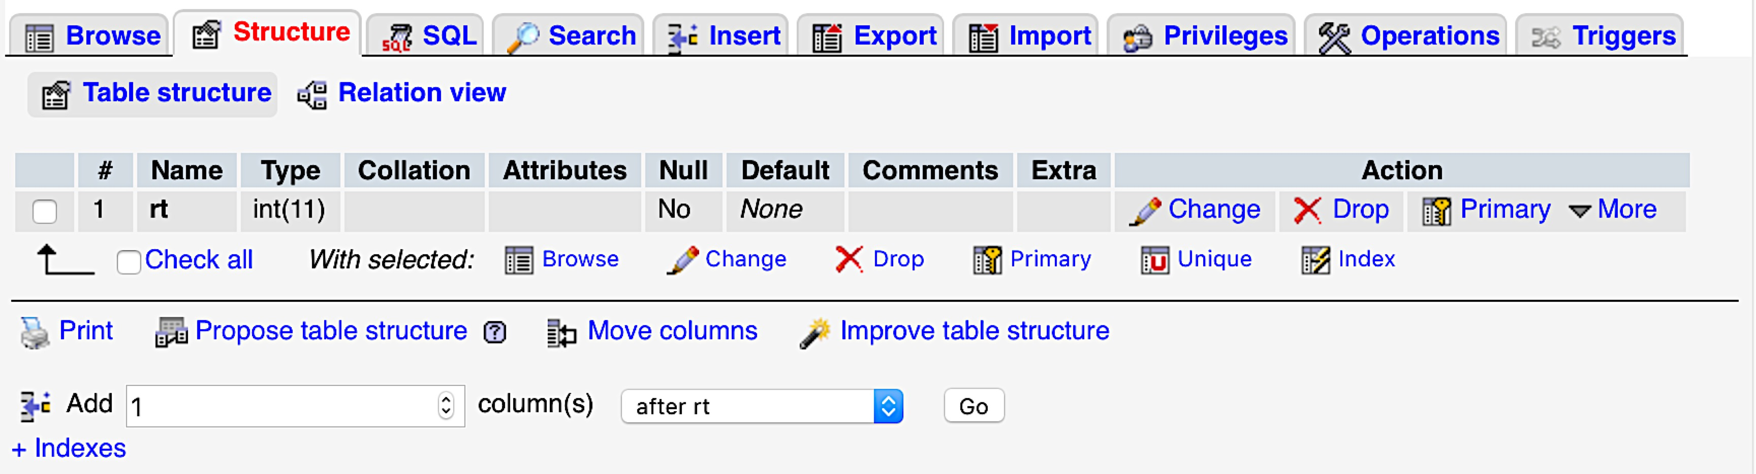
Get data into your MySQL table
You can manually add the necessary columns to your table via the structure tab

Slide 68
Get data into your MySQL table
This way can take a really long time if you have many keys sent per trial

Slide 69
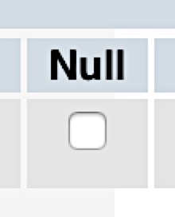
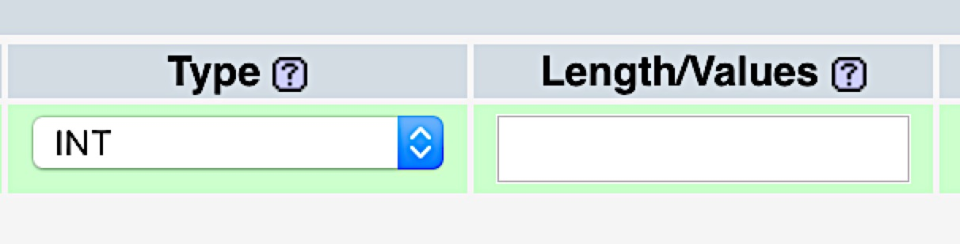
Get data into your MySQL table
So a brief explanation of the important inputs:

Slide 70
Get data into your MySQL table
So a brief explanation of the important inputs:
But now a quicker way to do this

Slide 71

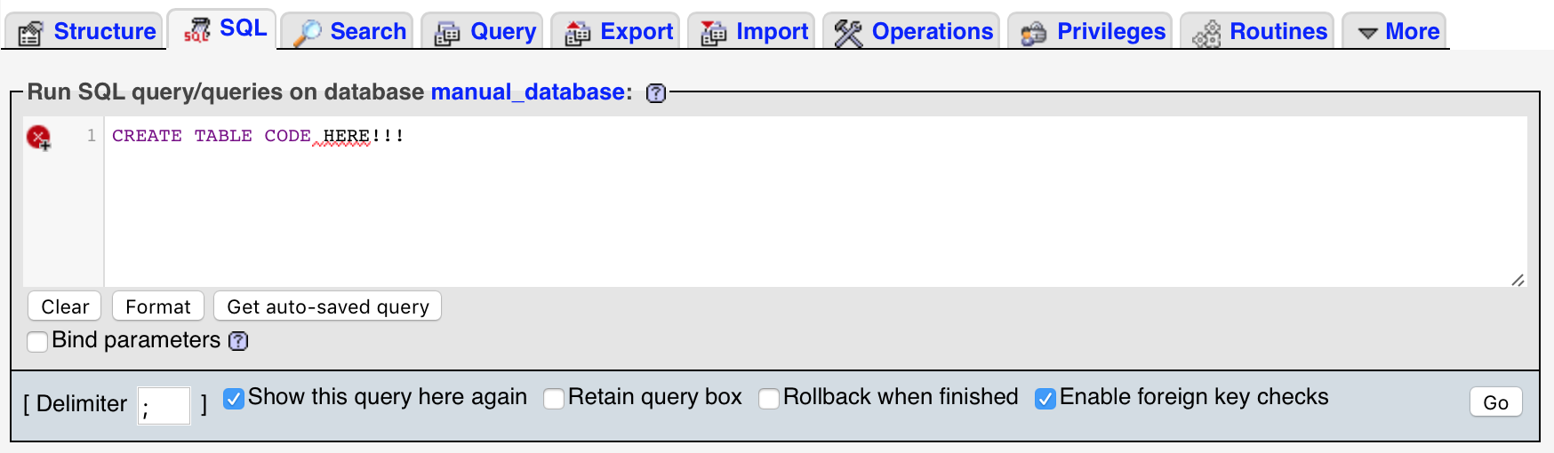
Get data into your MySQL table
To create a table and columns in one swoop:
1
3
CREATE TABLE `manual_table2` (
`rt` int(11) NOT NULL,
`key_press` smallint(11) NOT NULL,
`trial_type` varchar(200) NOT NULL,
`trial_index` smallint(6) NOT NULL,
`time_elapsed` int(11) NOT NULL,
`internal_node_id` varchar(300) NOT NULL,
`subject` int(11) NOT NULL,
`conditions` varchar(200) NOT NULL,
`stimulus` varchar(200) DEFAULT NULL,
`response` varchar(100) DEFAULT NULL,
`correct` varchar(100) DEFAULT NULL
) ENGINE=InnoDB DEFAULT CHARSET=utf8
COPY CODE:
2

Slide 72
Get data into your MySQL table
What do the specifications mean:
CREATE TABLE `manual_table2` (
`rt` int(11) NOT NULL,
`key_press` smallint(11) NOT NULL,
`trial_type` varchar(200) NOT NULL,
`trial_index` smallint(6) NOT NULL,
`time_elapsed` int(11) NOT NULL,
`internal_node_id` varchar(300) NOT NULL,
`subject` int(11) NOT NULL,
`conditions` varchar(200) NOT NULL,
`stimulus` varchar(200) DEFAULT NULL,
`response` varchar(100) DEFAULT NULL,
`correct` varchar(100) DEFAULT NULL
) ENGINE=InnoDB DEFAULT CHARSET=utf8

Slide 73
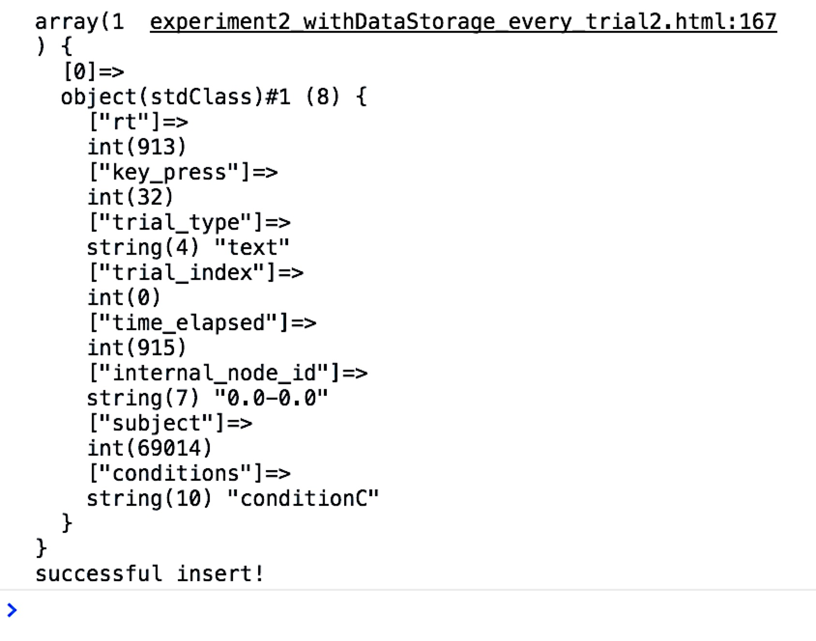
Get data into your MySQL table
Make sure to change the table name in your experiment file to manual_table2 (from manual_table1)
Then rerun your code, using developer tools
You should see:

Slide 74
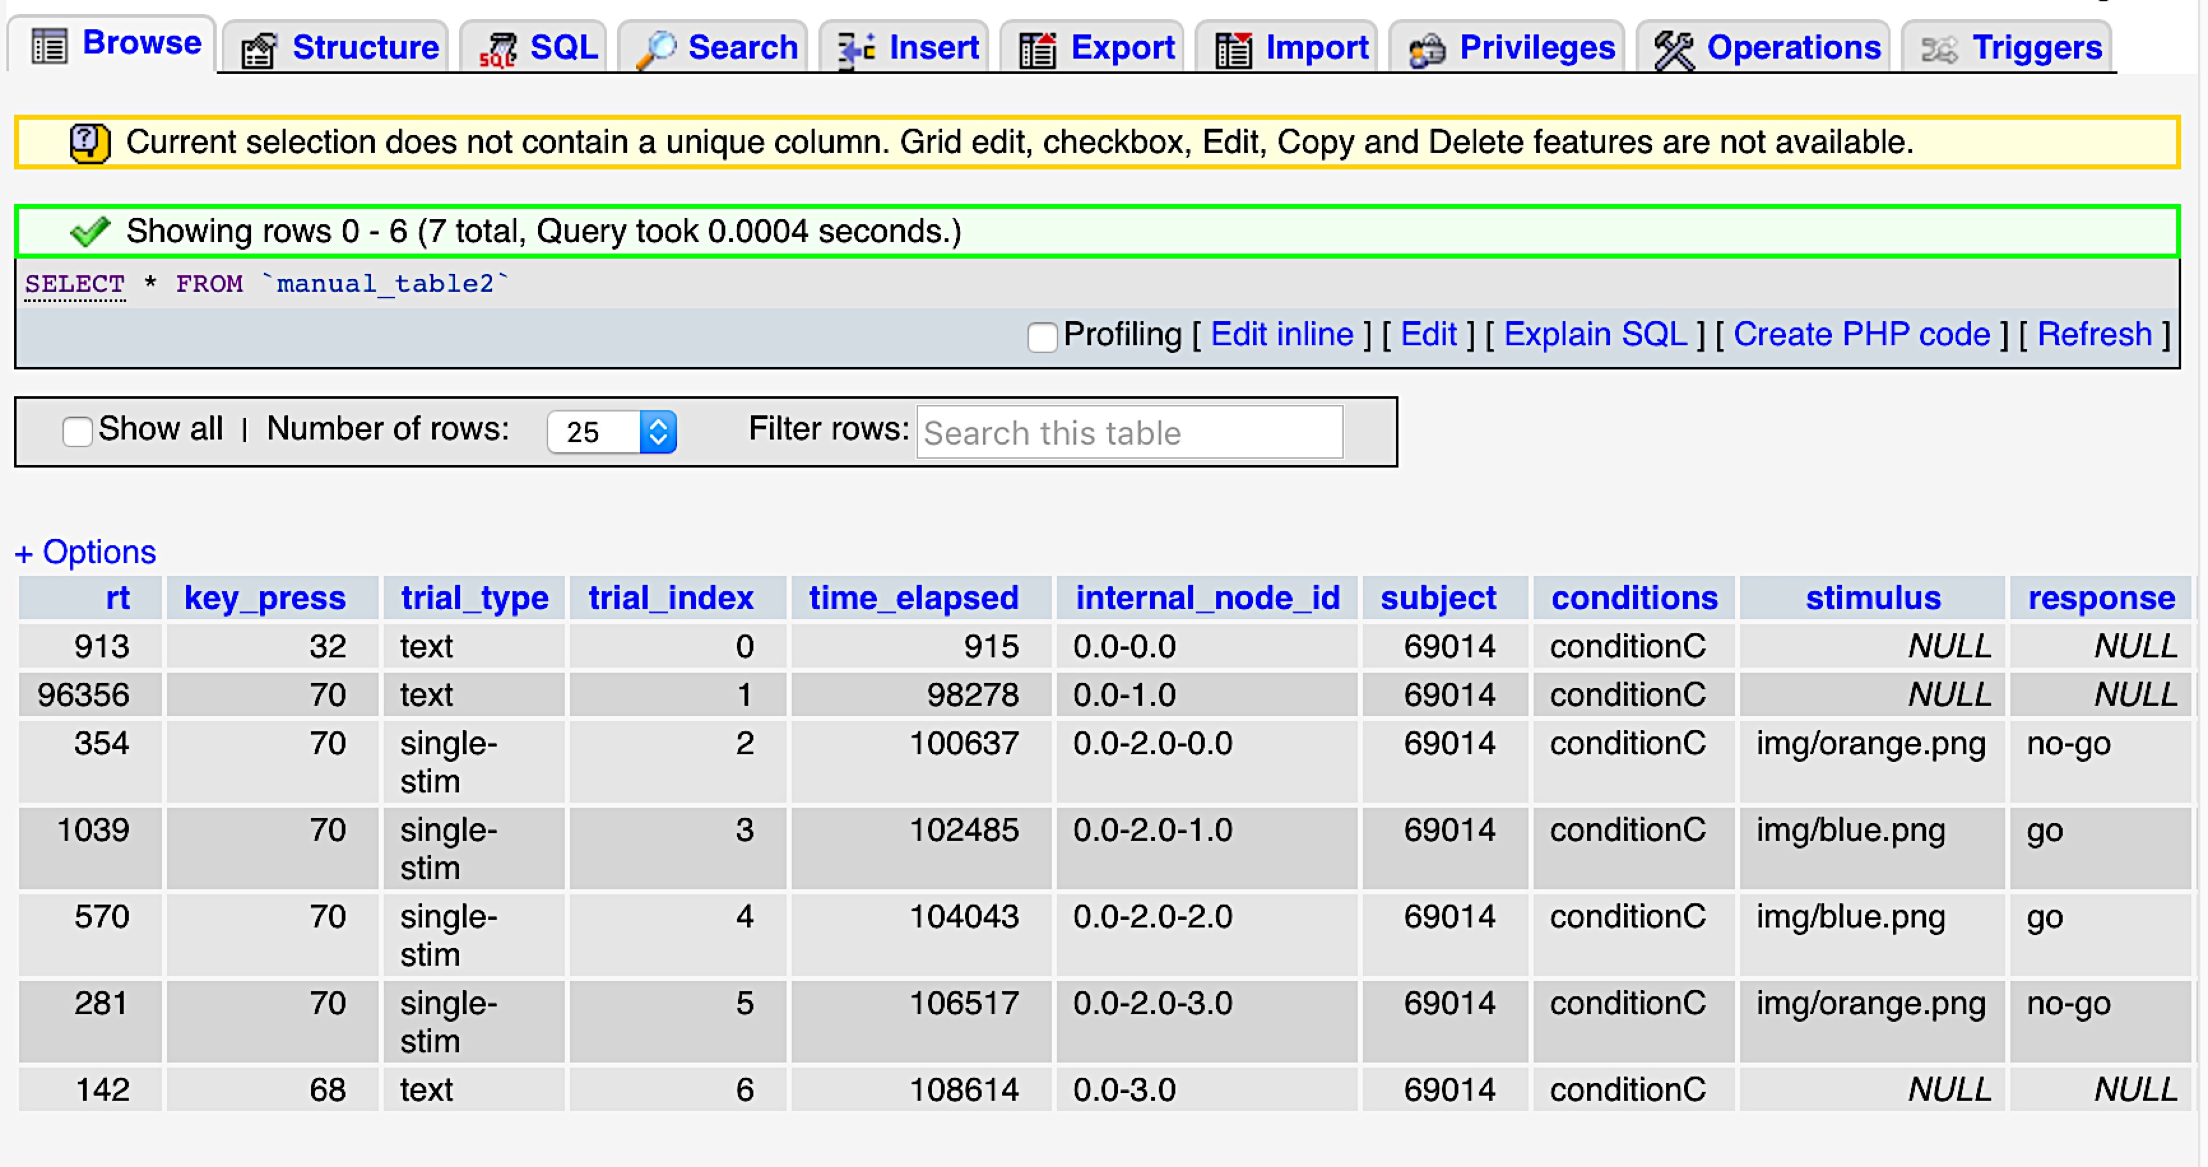
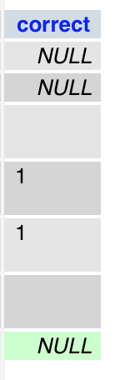
Get data into your MySQL table

Slide 75
Outline
Links & starting tips
Set up a local web development environment
Get going with jsPsych basics
Set up MySQL database and table
Hook jsPsych up with MySQL database & table
Understand MySQL table and data insertions
Use developer tools
Get your data into your MySQL table
Miscellaneous tips
MTurk basics

Slide 76
Miscellaneous tips
Developer tools
Sometimes if code isn’t working you’ll simply see a blank experiment screen
- the developer tools console however often automatically displays errors
In JavaScript you can display things to the console by adding: console.log(<stuff to display>)
- This is really helpful for debugging
- You can place this code in the <script> tags

Slide 77
Miscellaneous tips
MySQL: Get the code you need to recreate a table you already have
Have one table created and need another one or a similar one?

Slide 78
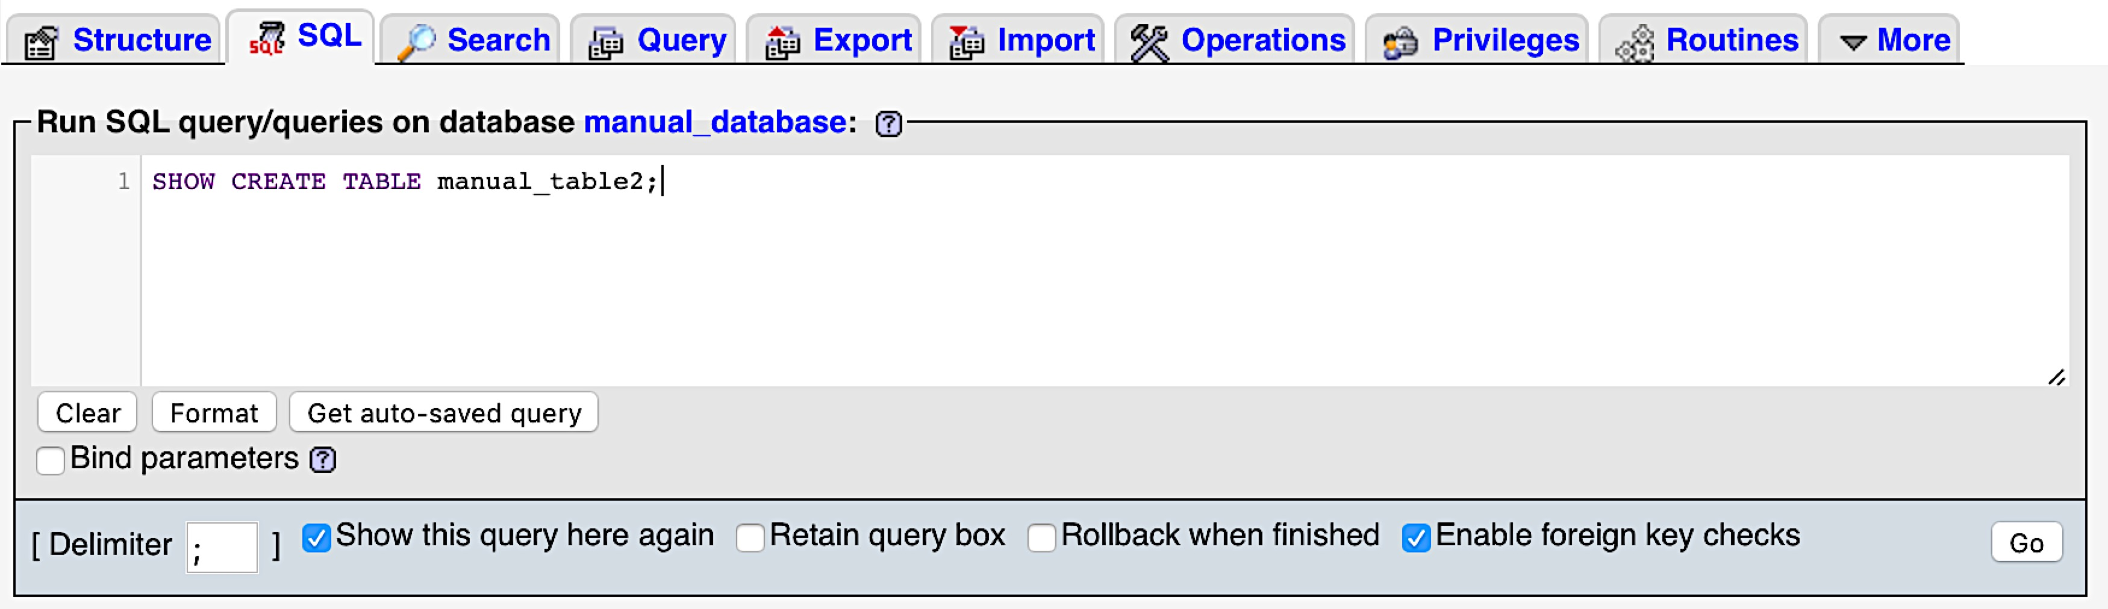
Miscellaneous tips
1
2
3

Slide 79
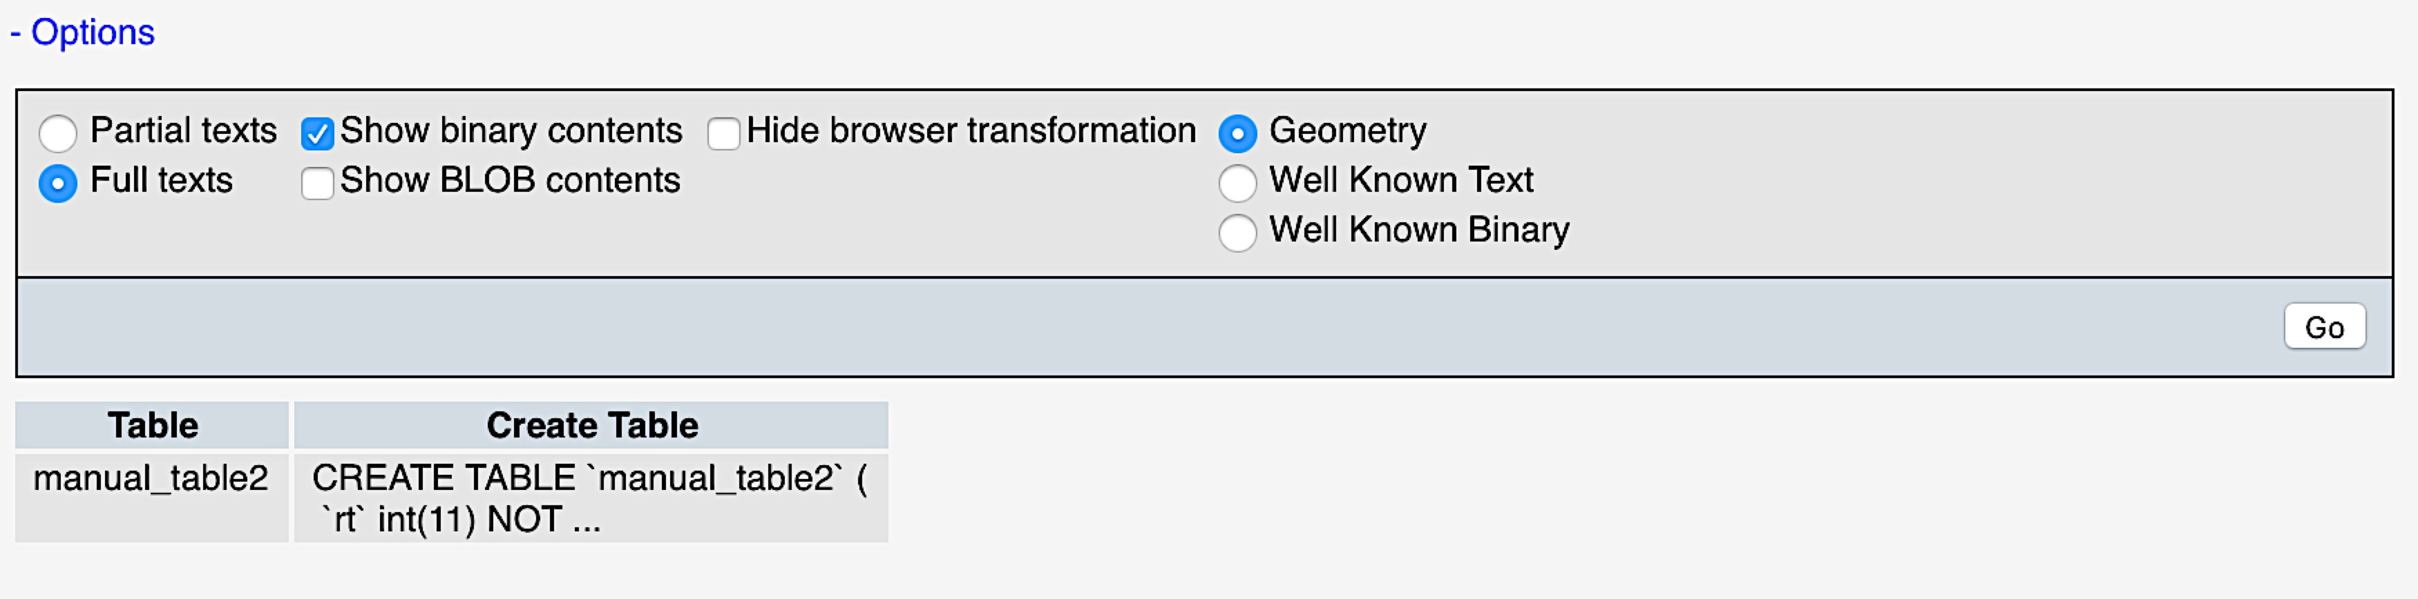
Miscellaneous tips
1
2

Slide 80
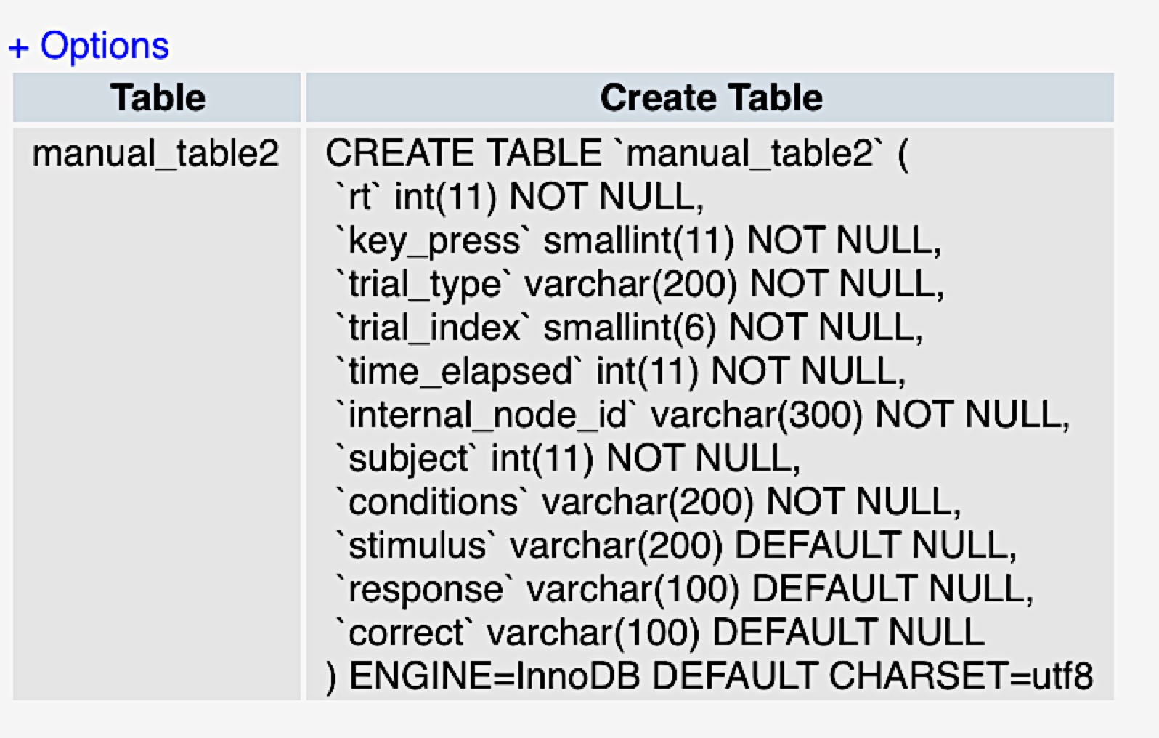
Miscellaneous tips

Slide 81
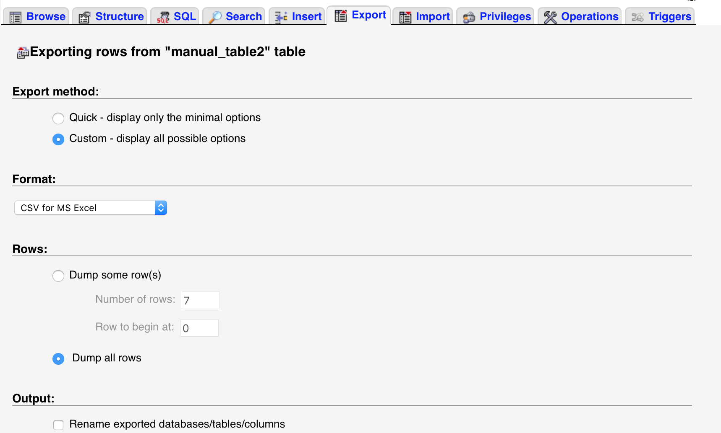
Miscellaneous tips
MySQL: Outputting the contents of your table to an excel file
1. Select the table you want to export, then select the following tab and options:

Slide 82
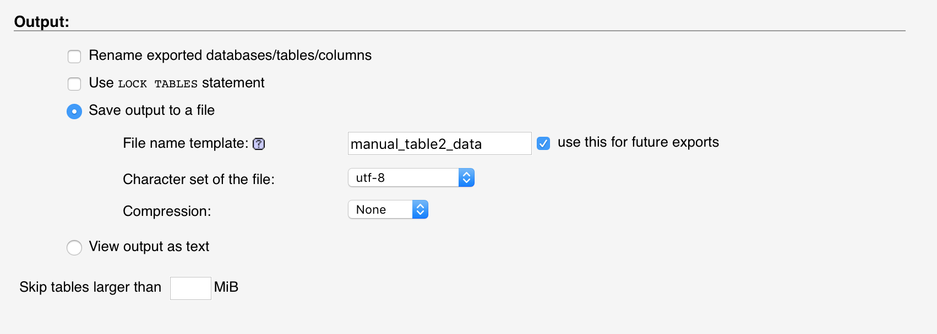
Miscellaneous tips
MySQL: Outputting the contents of your table to an excel file

Slide 83
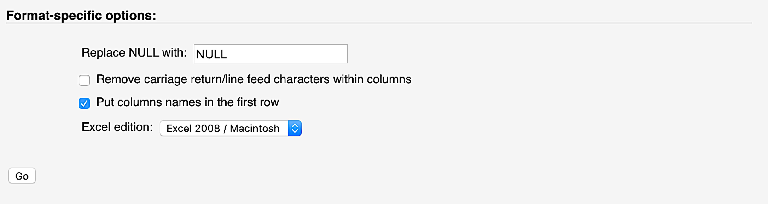
Miscellaneous tips
MySQL: Outputting the contents of your table to an excel file

Slide 84
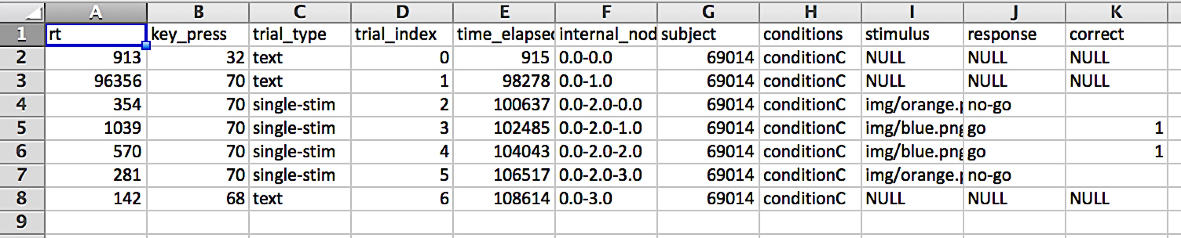
Miscellaneous tips
MySQL: Outputting the contents of your table to an excel file
Example file

Slide 85
Miscellaneous
Current experiment folder for MTurk study
FOLDER
mturk_study_example_RAS
THINGS TO CHANGE
- Change database_connect.php file to match your requirements
- Set the desired MySQL table in the experiment files
cr_mturk_session1.php
cr_mturk_session2.php
- These are old consent & debriefing forms

Slide 86
Miscellaneous
Current experiment folder for MTurk study
Includes
Checking for browser (Chrome / Mozilla)
Consenting in an external html form (via html plugin)
Obtaining and checking MTurk ID
Creating stimuli / html formatting
Online response scoring
Time stamps (UTC)
Final demographic and other questions we typically ask on MTurk
Some plugins I’ve changed (formatting/data logging/presentation changes)
- any plugin with RAS in it means it’s a modified jsPsych plugin
- so it may differ from online documentation
Note that the css has been altered (although I left name as is)
DISCLAIMER: if statements and exclamation points

Slide 87
Outline
Links & starting tips
Set up a local web development environment
Get going with jsPsych basics
Set up MySQL database and table
Hook jsPsych up with MySQL database & table
Understand MySQL table and data insertions
Use developer tools
Get your data into your MySQL table
Miscellaneous tips
MTurk basics

Slide 88
MTurk basics
- see MTurk link
- Requester login info
- see SubjectPaymentGuidelines_McDermottLab.docx, Sample_subjects_spreadsheet.xlsx, MTurk_subject_spreadsheet_inUse.xlsx (used for current study/based on Jeff’s spreadsheets)
- purchasing HITs; keeping track of MTurk participation and payment
- See section “For studies conducted on MTurk:”

Slide 89
MTurk basics
Create Tab
- walk through (copy previous for starting point)
- max 9 assignments per batch
- what an MTurk Worker sees/does

Slide 90
MTurk basics
Manage Tab
Results
- example batch (Results / Info)

Slide 91
MTurk basics
Manage Tab
Results
- example batch (Results / Info)
Workers
- can download full workers csv
- can help with checking qualifications were given correctly

Slide 92
MTurk basics
Manage Tab
Results
- example batch (Results / Info)
Workers
- can download full workers csv
- can help with checking qualifications were given correctly
Qualification Types
Why:
- Avoid repeat subjects (quals for given session + stimulus set)
- Allow specific subjects to complete follow-ups
How:
- Assign manually on individual worker page
- see MTurk subject page link example (replace <WORKER_ID>)
- Assign in groups via R (must have a HIT accepted by MCL first)
- see R code (contains MCL account info)

Slide 93
MTurk basics
R Code
Must have “MTurkR” in library to use

Slide 94
MTurk basics
R Code
Once a worker has had at least 1 HIT accepted by MCL, you can:
- give qualifications (previous slide)
- send emails to invite workers to complete future sessions (wait ~10min)
- see R code (contains MCL account info)

Slide 95
MTurk basics
R Code
Once a worker has had at least 1 HIT accepted by MCL, you can:
- give qualifications (previous slide)
- send emails to invite workers to complete future sessions (wait ~10min)
- see R code (contains MCL account info)
To test R code on yourself:
You cannot do this unless you have a HIT accepted from MCL account:
1. Create an Mturk worker account for yourself
2. Via the MCL account, create a HIT with 1 assignment worth $0.00
(Mturk will take a small %, which ends up at a cent or so)
3. Submit this hit with your Mturk worker account
4. Accept the HIT with the MCL account
Now forevermore (because you have at least 1 HIT accepted from MCL) you can test the R code qualifications and emails on yourself

Slide 96
MTurk basics
We get rated on lots of things, which then workers may use to determine if they will participate
Here are some things to try to always do when running a study on Mturk:
- check if HITs are valid quickly/ record HIT info, and then accept or reject HITs quickly
- have MCL’s email open (within reason) when HITs are available and try to respond quickly
- try to leave plenty of time for workers to finish the task
- if experiment takes 15min, allow ~40min to complete HIT on MTurk

Slide 97
Questions?

